Slide 1


GAME DEVELOPMENT & TECHNOLOGY
Building the Worlds of Tomorrow
Seminar Presentation | 2025

Slide 2



AGENDA
PART II: INNOVATION & IMPACT
PART I: FOUNDATIONS
•
Introduction to Game Development
•
Virtual Reality (VR) & AR
•
The Development Pipeline
•
Educational Benefits for Students
•
Core Engines & Languages
•
Future Scopes: AI, Cloud, Metaverse
•
Visual Tech: Ray Tracing
•
Q&A

Slide 3

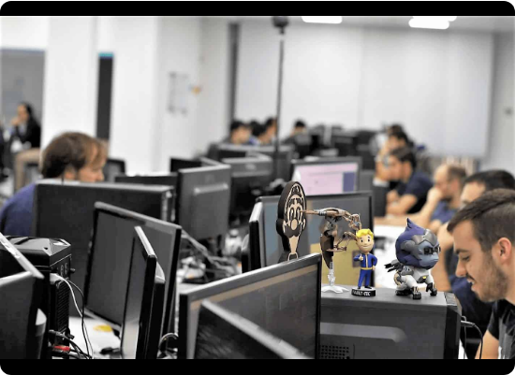
WHAT IS GAME DEVELOPMENT?
Game development is the art of creating games and describes the design, development, and release of a game. It may involve concept generation, design, build, test, and release.
It is a multidisciplinary field combining:
•
Computer Science: Programming & Logic
•
Creative Arts: Visual Design & Storytelling
•
Mathematics: Physics & Geometry
•
Psychology: User Experience & Reward Systems

Slide 4






THE DEVELOPMENT PIPELINE
PRE-PRODUCTION
PRODUCTION
POST-PRODUCTION
Asset creation (3D models, audio), coding (gameplay mechanics), and level design. The bulk of the work happens here.
Concept art, storyboarding, prototyping, and planning. This is the blueprint phase where the game's vision is defined.
Testing (QA), bug fixing, polishing, release, and post-launch support (DLCs, patches).

Slide 5


CORE TECHNOLOGIES: GAME ENGINES
THE POWERHOUSES
Modern games are built on robust frameworks called Game Engines. They handle rendering, physics, and input.
Unreal Engine 5: Known for photorealism, Nanite (geometry), and Lumen (lighting). Used in AAA titles and film production.
Unity: Versatile and accessible. Dominates the mobile and indie game market. Uses C# for scripting.

Slide 6








PROGRAMMING LANGUAGES
++
C++
C#
PYTHON
LUA
The industry standard for high-performance engine code. Used heavily in Unreal Engine.
The primary language for Unity. Easier to learn than C++ but powerful enough for complex logic.
Often used for pipeline tools, automation, and AI scripting rather than core gameplay.
A lightweight scripting language used in engines like Roblox and for modding support.

Slide 7
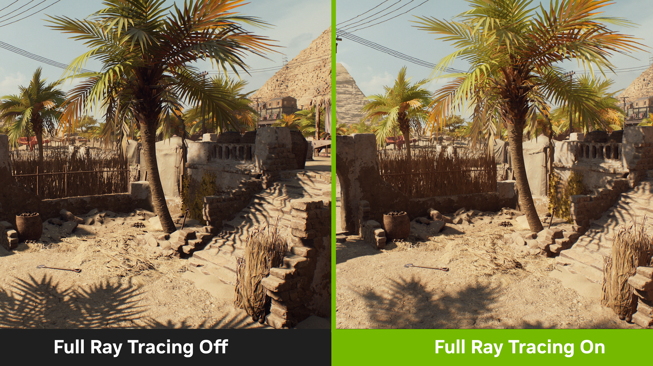
VISUAL TECH: RAY TRACING
Simulating Light Physics
Ray tracing renders light by simulating the physical behavior of light rays. It calculates the color of pixels by tracing the path that light would take if it were to travel from the eye of the viewer to the virtual 3D scene.
This allows for realistic reflections, refractions, and shadows that were previously impossible in real-time rendering, creating a massive leap in visual fidelity.

Slide 8

VIRTUAL REALITY (VR) IN GAMING
Total Immersion
VR places the player inside the game world, replacing their physical view with a digital one. It creates a sense of "presence" — the feeling of actually being there.
Key Concepts:
•
Stereoscopic 3D: Depth perception.
•
Head Tracking: The world moves as you look around.
•
6 Degrees of Freedom (6DoF): Move forward/back, up/down, left/right, plus rotation.

Slide 9






VR HARDWARE ECOSYSTEM
HMDS
CONTROLLERS
SENSORS & HAPTICS
Head-Mounted Displays: Devices like Meta Quest 3, PSVR 2, and Apple Vision Pro provide the visual portal.
Motion controllers track hand movements, allowing players to grab, throw, and interact with digital objects naturally.
Inside-out tracking cameras and haptic feedback suits/gloves that simulate touch and impact.

Slide 10
VR SOFTWARE CHALLENGES
Locomotion: Moving in VR without moving in real life can cause motion sickness. Developers use teleportation or "smooth locomotion" with blinders.
Performance: VR requires rendering the game twice (once for each eye) at high frame rates (90FPS+) to maintain smoothness and prevent nausea.
Interaction Design: Standard UIs don't work. Menus must be diegetic (existing within the world) or spatial, floating in 3D space.

Slide 11

AUGMENTED REALITY (AR)
BLURRING THE LINES
Unlike VR, which replaces reality, AR overlays digital content onto the real world. Games like Pokémon GO proved the massive potential of AR.
Future of AR:
With devices like AR glasses, gaming can become ubiquitous, turning city streets into game levels and living rooms into battlefields, blending physical exercise with digital play.

Slide 12

ED-TECH: LOGIC & PROBLEM SOLVING
Coding as a Superpower
Learning game development teaches students the core of computer science: logic.
•
Algorithmic Thinking: Breaking complex problems into step-by-step solutions.
•
Debugging: The process of finding and fixing errors teaches patience and analytical skills.
•
Systems Thinking: Understanding how different variables (health, speed, gravity) interact.

Slide 13
ED-TECH: UNLEASHING CREATIVITY
"Game development is the ultimate canvas. It combines music, art, narrative, and logic into a single interactive experience."
— Modern Educator
Students learn to design characters, compose soundtracks, write branching narratives, and build 3D worlds, fostering a holistic creative skillset.

Slide 14



ED-TECH: SOFT SKILLS
TEAMWORK
RESILIENCE
COMMUNICATION
Games are rarely made alone. Students learn to collaborate, use version control (Git), and manage tasks.
Game dev is full of failure. Code breaks, mechanics aren't fun. Learning to "fail fast" and iterate builds grit.
Explaining a technical bug to an artist or a design idea to a programmer requires clear, effective communication.

Slide 15
ADVANTAGES: CAREER OPPORTUNITIES
Technical Roles: Gameplay Programmer, Engine Programmer, AI Specialist, DevOps Engineer.
Artistic Roles: 3D Modeler, Concept Artist, Animator, VFX Artist, Technical Artist.
Design Roles: Level Designer, Narrative Designer, Systems Designer, UX/UI Designer.
Production: Producer, Product Manager, QA Tester, Community Manager.

Slide 16
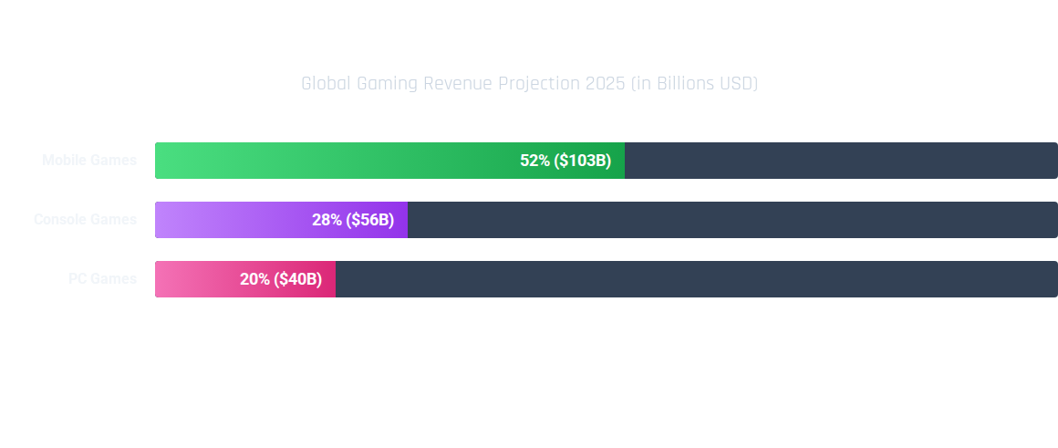
INDUSTRY ECONOMIC IMPACT
The gaming industry is now larger than the film and music industries combined, offering massive economic potential.

Slide 17

FUTURE SCOPE: AI INTEGRATION
SMARTER WORLDS
Artificial Intelligence is revolutionizing gaming beyond just enemy behavior.
•
Generative AI: Creating endless content (quests, textures, dialogue) automatically.
•
Smart NPCs: Non-Playable Characters that can hold dynamic, unscripted conversations (using LLMs).
•
Personalization: Games that adapt their difficulty and story based on the player's psychology.

Slide 18


FUTURE SCOPE: CLOUD GAMING
GAMING ANYWHERE
Cloud gaming removes the hardware barrier. Games are processed on powerful servers and streamed to your device like a Netflix video.
Implications:
•
Play AAA graphics on a budget smartphone.
•
No downloads or updates required.
•
True cross-platform compatibility.

Slide 19

FUTURE SCOPE: THE METAVERSE
The Next Internet?
The Metaverse envisions a persistent, shared, 3D virtual space where users interact as avatars.
Game technology is the foundation of the Metaverse. It combines VR, social networking, and digital economies (blockchain/NFTs) to create virtual societies where people can work, play, and socialize without physical constraints.

Slide 20
ETHICAL CONSIDERATIONS
Addiction: Designing engaging loops without exploiting vulnerability. Developers must balance retention with player well-being.
Accessibility: Ensuring games are playable by people with disabilities (color blindness modes, adaptive controllers).
Data Privacy: VR headsets collect biometric data (eye movement, gait). protecting this user data is paramount.
Monetization: Moving away from predatory "loot boxes" towards transparent value exchange.

Slide 21

Q & A
Thank you for your attention.

